Slide 1

MidTerm ProjecT
DSF-2024
Urs Habegger &
Nino Schwaller

Slide 2
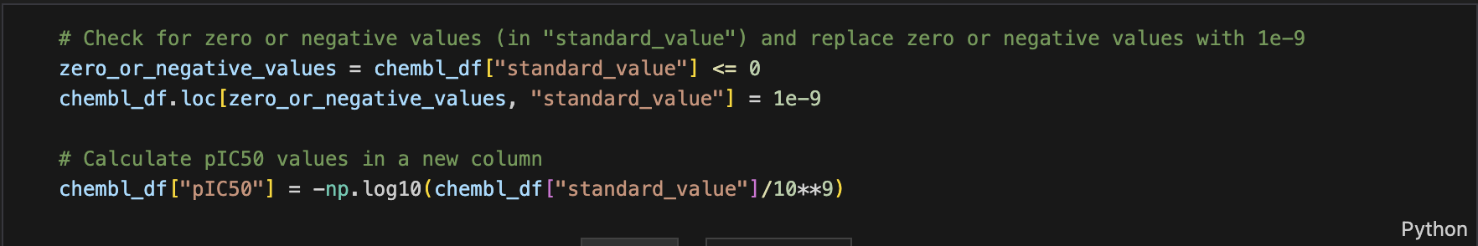
Tutorial - Problems
Calculation of pIC50 values: -log() function
  Error with zero-values in dataset
  Replace values with NaN
    -> test loss = NaN
  Replace 0 with 10⁻⁹ nM

Slide 3
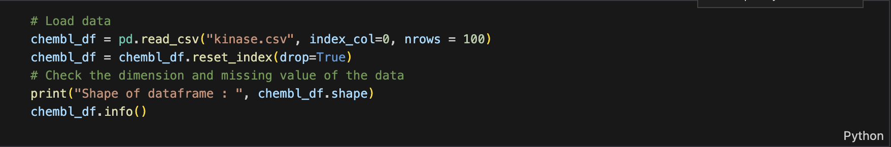
TUTORIAL - PROBLEMS
Generation of fingerprint takes very long
  Only import first 100 rows of dataset to test code / debugging

Slide 4
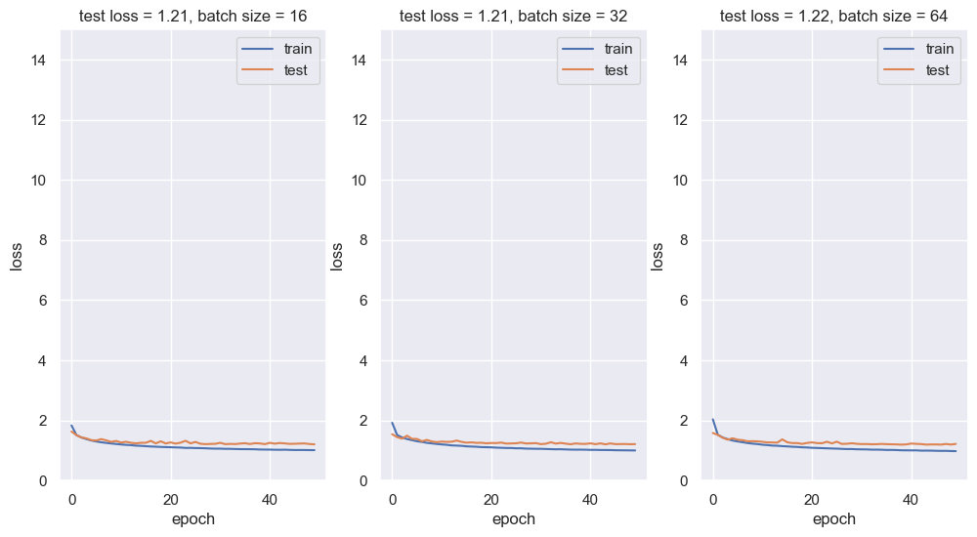
Tutorial - Results
Test-loss varies between runs
Batch-size = 16

Slide 5
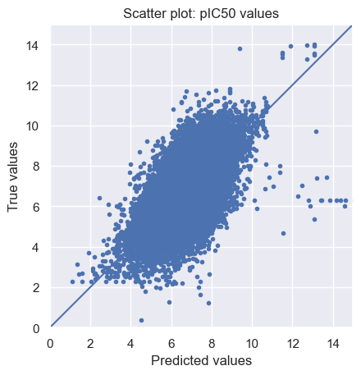
TUTORIAL - RESULTS

Slide 6
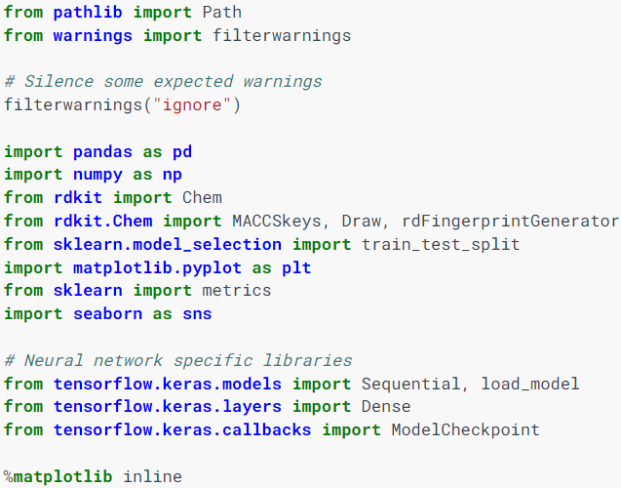
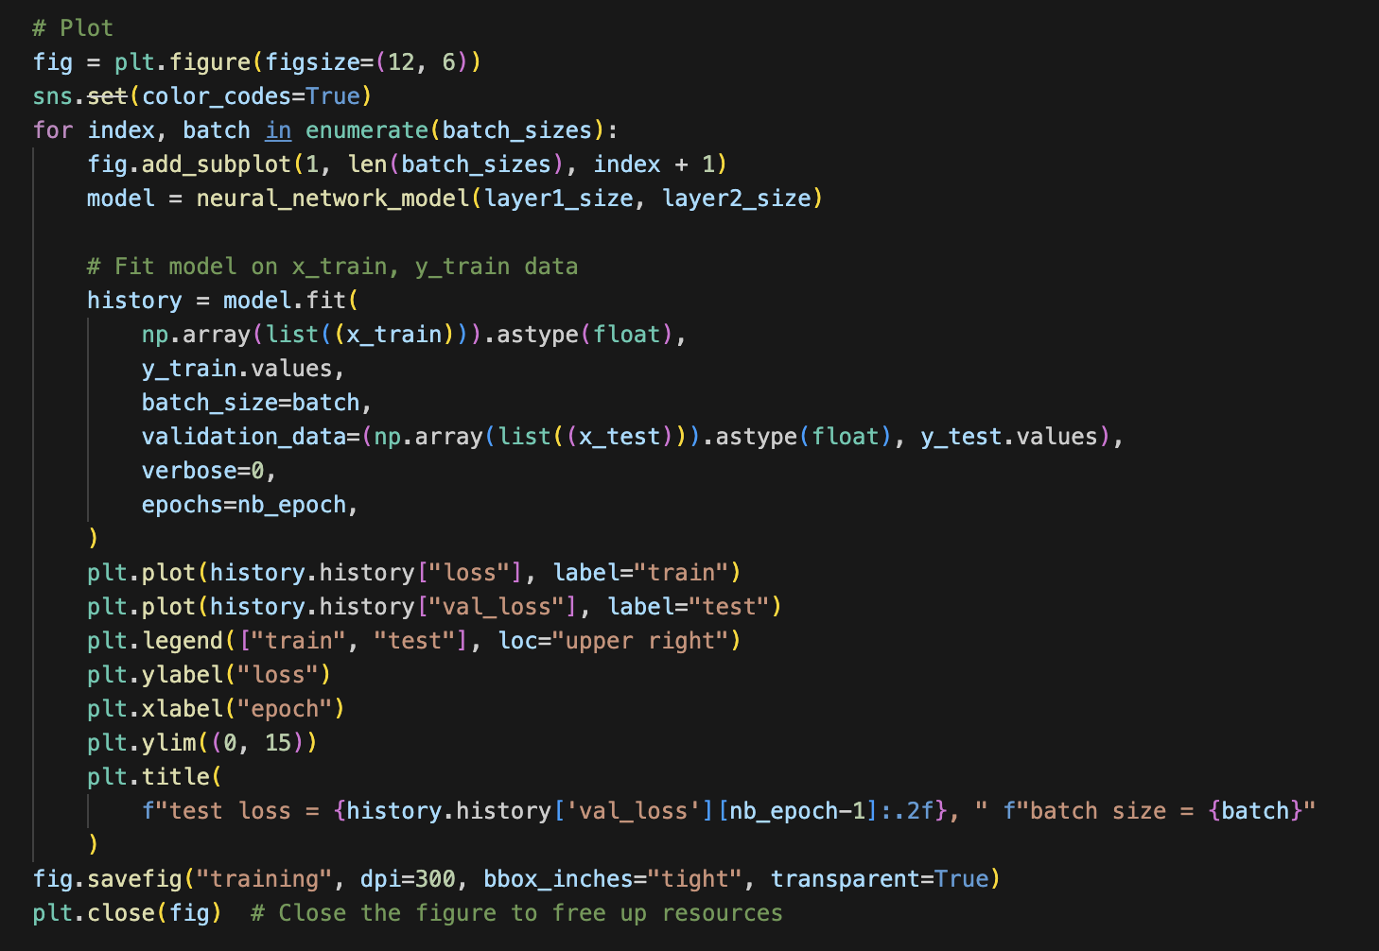
Road to UBELIX
Code Adjustments:
  Remove %matplotlib inline: specific to Jupyter Notebook
  Save Plots to Files: using plt.savefig().
  Create .py file

Slide 7
ROAD TO UBELIX
Test code locally in terminal:
  Create venv
  Install pyhton packages:
  Run .py file
  Create requirements.txt file
pandas
numpy
scikit-learn
matplotlib
tensorflow
rdkit
seaborn
setuptools

Slide 8
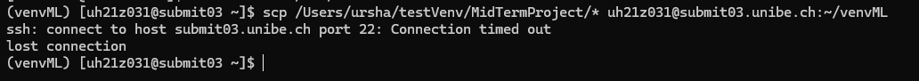
ROAD TO UBELIX
Open ssh session
Load newer version of python: module load Python
Create venv, install packages
Transfer files from local to UBELIX
  scp /Users/user1/testVenv/MidTermProject/* username@submit03.unibe.ch:~/venvML
  FileZilla
Install packages using requirements.txt
  Install tensorflow package manually

Slide 9
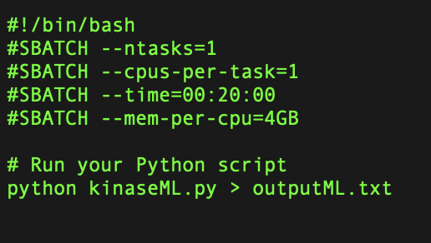
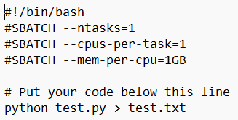

ROAD TO UBELIX
Create SLURM testJob.sh file
Create SLURM job .sh file:
  Enough time
  Enough memory per cpu
Submit job & wait
  Took sometimes multiple hours to be executed

Slide 10
UBELIX - Problems
python: error while loading shared libraries: libpython3.10.so.1.0: cannot open shared object file: No such file or directory
python: error while loading shared libraries: libpython3.10.so.1.0: cannot open$
Traceback (most recent call last):
  File "/storage/homefs/ns21y024/venvML/kinaseML.py", line 8, in <module>
  import pandas as pd
  ModuleNotFoundError: No module named 'pandas'
-> Install packages on UBELIX User, not venv

Slide 11
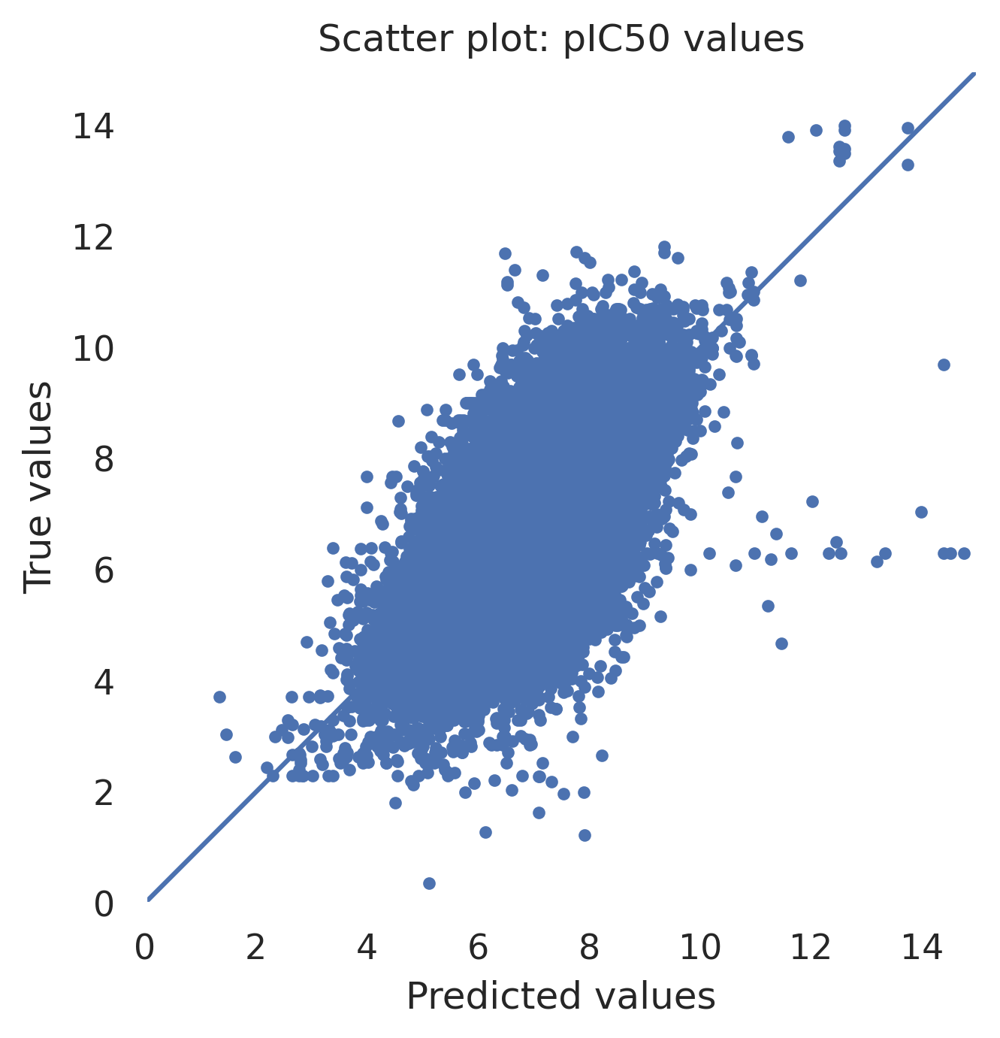
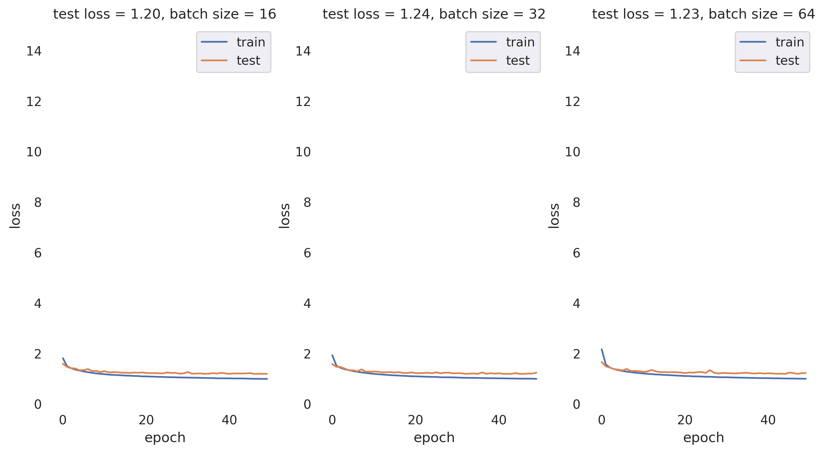
UBELIX - RESULTS

Slide 12
UBELIX
Advantage of UBELIX?
  Python script ran for ~20min on personal computer
  Python script ran for ~20min on UBELIX
    + need to adapt script for terminal
    + no direct debugging
    + submit job & wait

